Slide 1
Financial Education in Schools
12+4
50
130
Here is where your presentation begins

Slide 2
Contents of this template
You can delete this slide when you’re done editing the presentation
Fonts | To view this template correctly in PowerPoint, download and install the fonts we used
Used and alternative resources | An assortment of graphic resources that are suitable for use in this presentation
Thanks slide | You must keep it so that proper credits for our design are given
Colors | All the colors used in this presentation
Icons and infographic resources | These can be used in the template, and their size and color can be edited
Editable presentation theme | You can edit the master slides easily. For more info, click here
For more info:
SLIDESGO | BLOG | FAQs
You can visit our sister projects:
FREEPIK | FLATICON | STORYSET | WEPIK | VIDEVO

Slide 3
Template with Wordart
Wordart
This is WordArt text. If you want to modify it:
Double click on it
Type your new text in the dialog box
You can change the fill color in the top menu
You can also modify the stroke, its color, thickness or type
Press Enter
3x2

Slide 4
Table of contents
01
02
03
04
Definition
Importance
You can describe the topic of the section here
You can describe the topic of the section here
Components
Activities
You can describe the topic of the section here
You can describe the topic of the section here

Slide 5
Whoa!
94x10
3x2
This can be the part of the presentation where you introduce yourself, write your email…
22

Slide 6
01
Definition
50
12+4
You can enter a subtitle here if you need it

Slide 7
Financial education in schools
Mercury is the closest planet to the Sun and the smallest one in the Solar System. This planet's name has nothing to do with the liquid metal, since Mercury was named after a Roman god. Its surface is similar to that of Earth’s Moon
There are a lot of craters and plains. Speaking of craters, many of them were named after artists or authors who made significant contributions to their respective fields. Mercury takes a little more than 58 days to complete its rotation

Slide 8
It can make a difference!
Do you know what helps you make your point clear? Lists like this one:
They’re simple
You can organize your ideas clearly
You’ll never forget to buy milk!
And the most important thing: the audience won’t miss the point of your presentation
3x2
22

Slide 9
Financial education importance
Optimise your resources
Manage your money
Mercury is the closest planet to the Sun and the smallest one in the Solar System. It was named after the Roman messenger god
Venus has a beautiful name and is the second planet from the Sun. It’s terribly hot and has a poisonous atmosphere

Slide 10
Types of finance
Public finance
Corporate finance
Personal finance
Mercury is the closest planet to the Sun and the smallest one in the entire Solar System
Venus has a beautiful name and is the second planet from the Sun. It is a terribly hot planet
Earth is the third planet from the Sun and the only one that harbors life in the Solar System

Slide 11
Financial literacy skills
Create a budget
Pay yourself first
Mercury is the closest planet to the Sun and the smallest one in the Solar System
Venus has a beautiful name and is the second planet from the Sun. It is extremely hot
Pay bills promptly
Learn to save money
Earth is the third planet from the Sun and the only planet that harbors life
Despite being red, Mars is actually a cold place. It is full of iron oxide dust

Slide 12
Basics of money management
Budgeting
Saving
Debt
Mercury is the smallest planet in the Solar System
Venus has a cute name and is the second planet
Earth is the third planet and where all humans live
Giving
Investing
Spending
Despite being red, Mars is actually a cold place
Jupiter is a gas giant and the biggest planet
Saturn is a gas giant and has several beautiful rings

Slide 13
Awesome words
50
130
12+4

Slide 14
—Someone Famous
“This is a quote, words full of wisdom that someone very important said and can make the reader get inspired.”
22
94x10

Slide 15

A picture is worth a thousand words

Slide 16

A picture always reinforces
the concept
Images reveal large amounts of data, so remember: use an image instead of a long text. Your audience will appreciate it

Slide 17
98,300,000
17
Big numbers catch your audience’s attention
33+50

Slide 18
9h 55m 23s
386,000 km
333,000
Jupiter's rotation period
94x10
Distance between Earth and the Moon
The Sun’s mass compared to Earth’s
22

Slide 19
Financial education is useful!
25%
50%
75%
Save more money
Have a bank account
Better money management
Mercury is the closest planet to the Sun and the smallest of them all
Venus has a beautiful name and is the second planet from the Sun
Earth is the third planet and the only one that harbors life in the Solar System

Slide 20
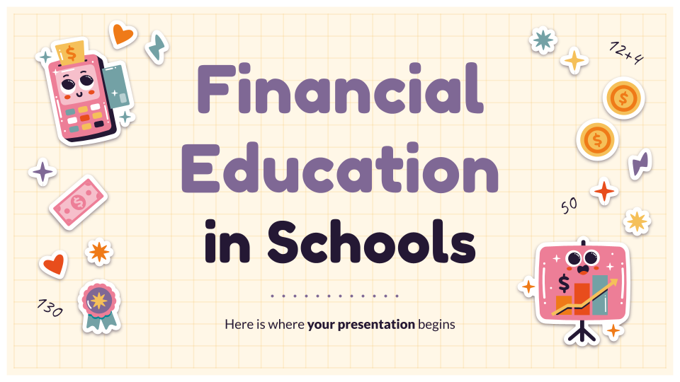
Computer mockup
You can replace the image on the screen with your own work. Just right-click on it and select “Replace image”

Slide 21
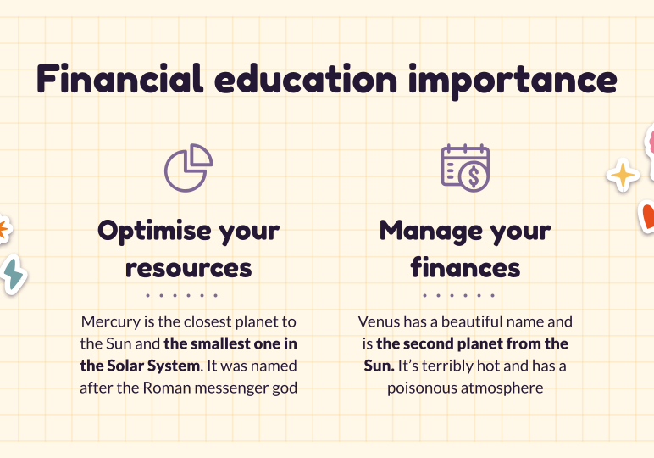
Tablet mockup
You can replace the image on the screen with your own work. Just right-click on it and select “Replace image”

Slide 22
Smartphone mockup
You can replace the image on the screen with your own work. Just right-click on it and select “Replace image”

Slide 23
Financial education by country
England
Mercury is small and the closest planet to the Sun
Canada
Venus is the second planet from the Sun
Norway
The Earth is the only planet that harbors life

Slide 24
History of financial education
Entirely informal
First time taught
Mercury is very small and the closest planet to the Sun
Earth is the third planet and the only one that harbors life
Early years
19th century
20th century
Today
James Gilbart
Taught in schools
Venus has a beautiful name and is the second planet from the Sun
Despite being red, Mars is a cold place. It is full of iron oxide dust

Slide 25
Key lessons of financial education
Have fewer credit cards
Comparison shopping
Mercury is small and the closest planet to the Sun
The Earth is the only planet that harbors life
Always pay debts on time
Always have good savings
Venus has a beautiful name and is the second planet
Despite being red, Mars is actually a cold place

Slide 26
Education makes a difference!
Personal financial behaviours | People who received financial education | People who did not receive financial education
Set money aside for savings | 95% | 50%
Set money aside for retirement | 90% | 30%
Pay bills promptly | 86% | 42%
Have a weekly/monthly budget | 87% | 25%
Do comparison shopping | 97% | 44%

Slide 27
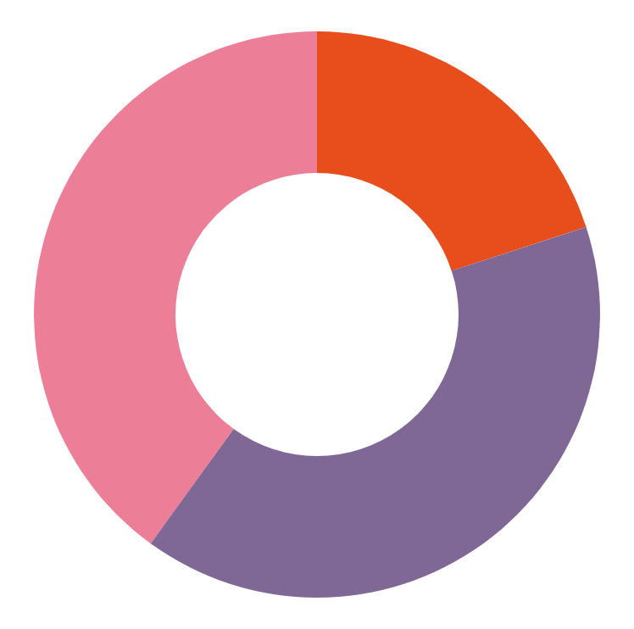
Who is more financially educated?
20s - 30s (20%)
40s - 50s (40%)
60s and older (40%)
Mercury is the closest planet to the Sun and the smallest of them all
Venus has a beautiful name and is the second planet from the Sun
Follow the link in the graph to modify its data and then paste the new one here. For more info, click here
Earth is the third planet the only one that harbors life in the Solar System

Slide 28


Our teachers
12+4
Sofia Hill
Kaliyah Harris
You can speak a bit about this lovely person here
You can speak a bit about this lovely person here
130

Slide 29
04
Activities
45-5
You can enter a subtitle here if you need it

Slide 30
Choose the correct answer
Directions: Read the statements and choose the correct answer filling the text box
01
There are three types of finance…
A
Public finance, corporate finance and personal finance
B
Children finance, love finance and social finance
02
Three key lessons of financial education are...
A
Have fewer credit cards, pay your debts on time and have good savings
B
Buy everything you want, invest your money and make a monthly budget

Slide 31
True or false
Directions: Read the statements and choose true or false
Statements | True | False
Financial education is a core life skill for participating in modern society
Including financial education into the school is not important
People who have received financial education have more debt
There are 3 types of financial education: personal, corporate and public
Budgeting and saving are basic aspects of money management

Slide 32
Connect the columns
Directions: Read the statements and drag the line to the correct information in the columns
Financial education help you to optimize
financial education skills
Public finance and personal finance are
save more money
Create a budget and pay bills promptly are
financially well-educated
People who received financial education
your resources
People in their 40s and 60s are
two types of finance

Slide 33
Debit cards or credit cards?
Directions: Read some features of debit cards and credit cards. Write A next to the features you think are advantages. Write D next to the features you think are disadvantages
Debit cards
Credit Cards
A
Do not have to carry cash
D
Balances can quickly increase
May include a fee for each purchase
May include a yearly fee
Need a PIN to access the account
Must pay interest on unpaid balance
Need enough money in account to cover the cost of purchases
Can make purchases without having
money to cover the full price

Slide 34
Establishing credit history
Directions: Read the statements. Decide whether a bank would regard each statement as a positive or negative factor in deciding whether to approve a loan application
He/She pays credit card balance monthly and on time
He/She recently lost his/her job and is looking for work
He/She is currently repaying student loans and a loan to start a business
He/She sets money aside for retirement and savings
He/She has a permanent job with a good salary

Slide 35
Create a personal budget
Directions: Jenna is making a 4-week budget. Complete the table. How much money does Jenna have available at the end of 4 weeks?
Expenses: entertainment: $15, snacks—$10
Planned savings: college fund—$20
Description | Income | Expenses | Amount available
Earnings ($25 babysitting each weekend) |  |  | $100
College fund
Entertainment
Snacks

Slide 36
Thanks!
77x90
Do you have any questions?
youremail@freepik.com
+34 654 321 432
yourwebsite.com
149
Please keep this slide for attribution

